Slide 1
Thesis Discussion
Emilio Benenati
Josyula Viswanath Das

Slide 2
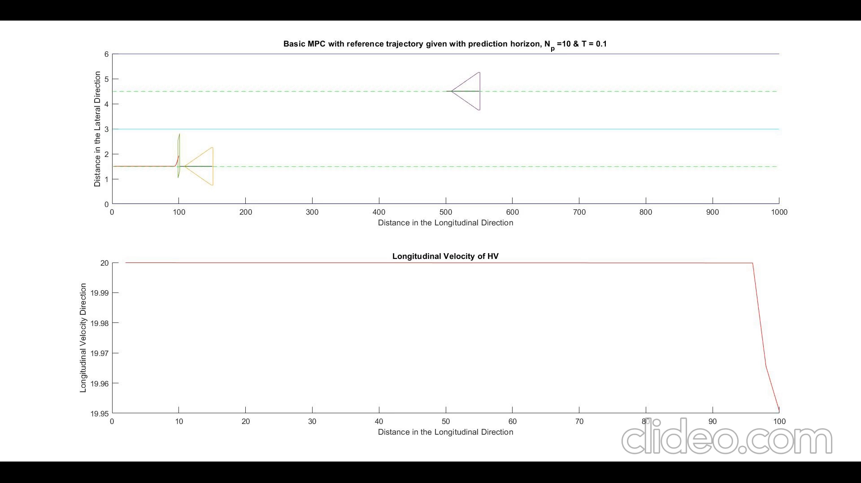

Slide 3


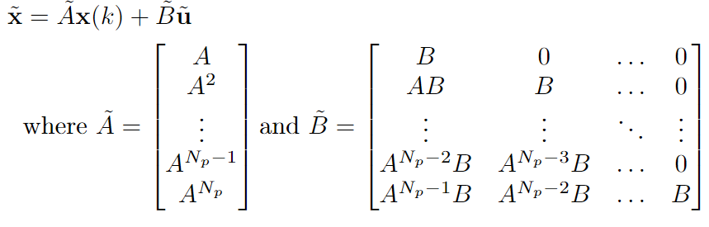
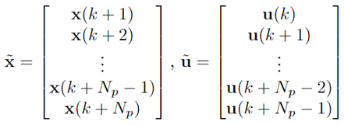
Basics
Basic Equations to keep in mind.

Slide 4
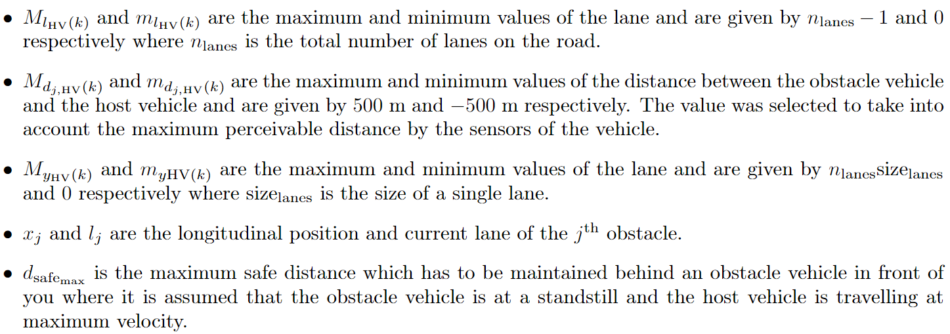
Basics

Slide 5
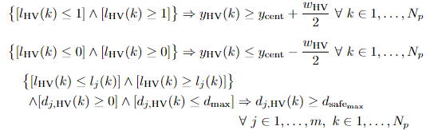
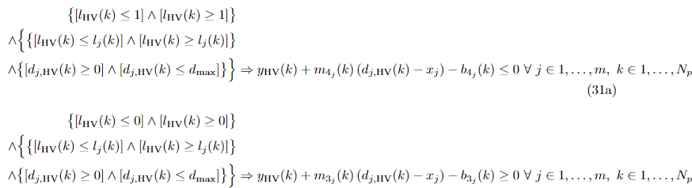
MLD Constraints
If safe area is occupied logical constraints can be written as
If safe area is unoccupied

Slide 6
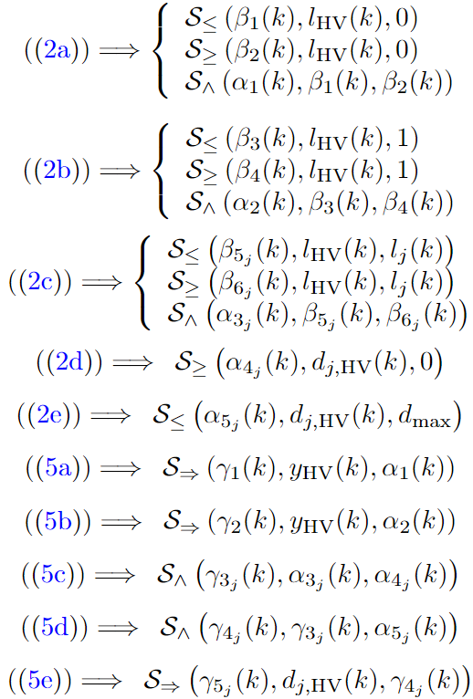
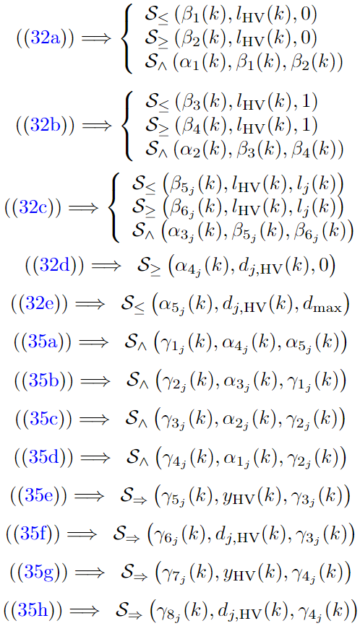
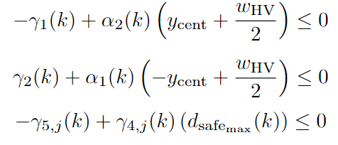
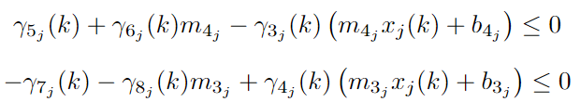
IF SAFE AREA IS OCCUPIED | IF SAFE AREA IS UNOCCUPIED

Slide 7


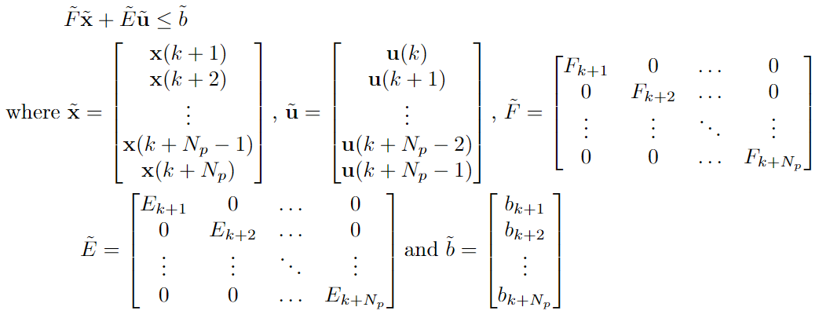

These equations can be written in the form of
or
If we write the equations as in the first case, then the MLD constraints over the prediction horizon can be written as a function of input directly as
And then by substituting the value of from the first slide, we get

Slide 8
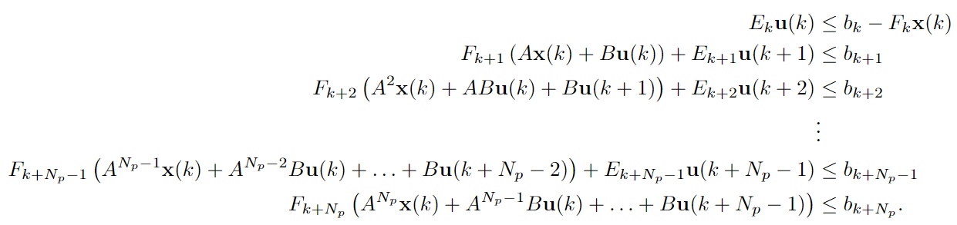
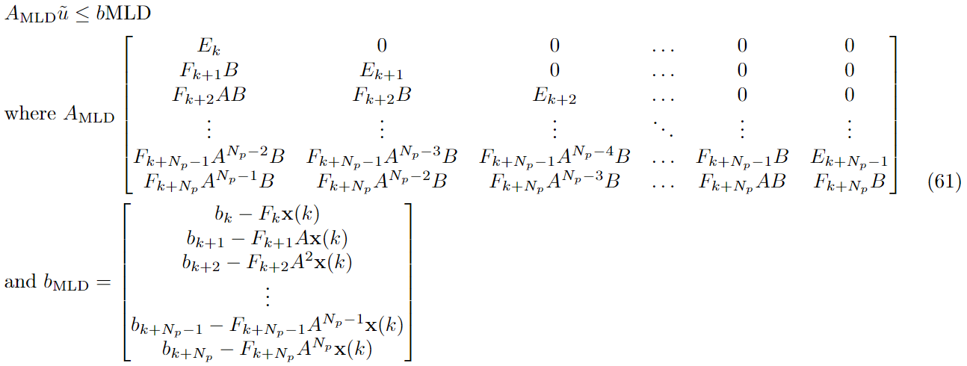
If we write the equations as in the second case, then the MLD constraint expanded over the horizon can be written as
The above can be written in matrix form as

Slide 9
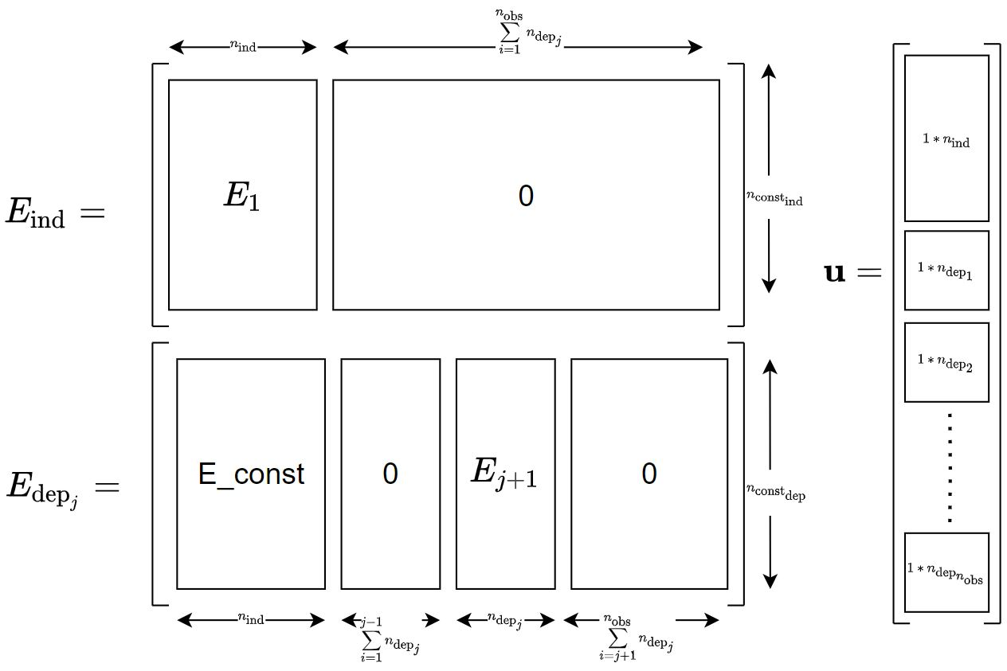
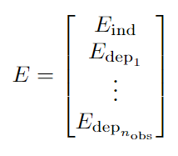
The E matrix above can be divided based on input variables that are dependent on the j^{th} obstacle and which are not. We can therefore write the E matrix as

Slide 10

Why did not use l_{HV}(k) $ε${0,1} ?
When using this we write the

